Slide 1


Academy
Python 101
Anthony McKale Principal Software Engineer

Slide 2
Python 101
Today we’ll cover :
Python Facts
Variables
Operators
Control Flow
Functions
OO and beyond basics will be covered later date

Slide 3
PYTHON FACTS

Slide 4
Python Facts
Born in the late 80’s by a chap called “Guido”
Named after Monty Python’s Flying Circus
Modern Python 3.0 came out in 2008
Adopted as the language of choice by Data Scientists
Adopted around the world as “hardcode” heavy lifting language for CPU bound applications …rust slowly taking over though
Though, Python is changing fast, new versions every year, with new incompatible features…

Slide 5
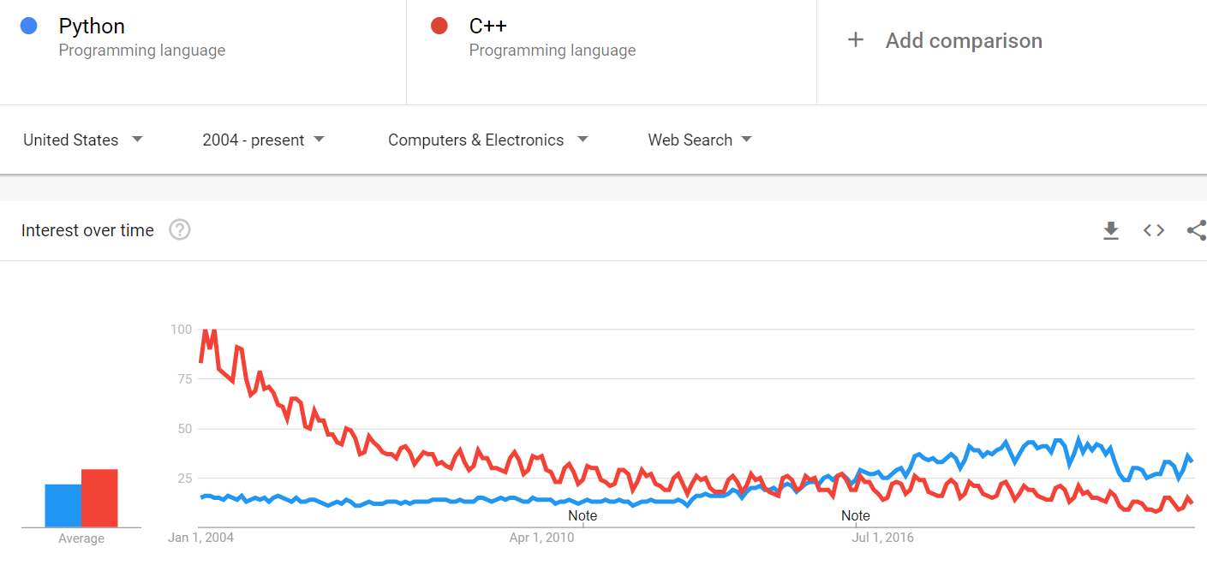
Python Facts
One of the most popular languages in the world

Slide 6
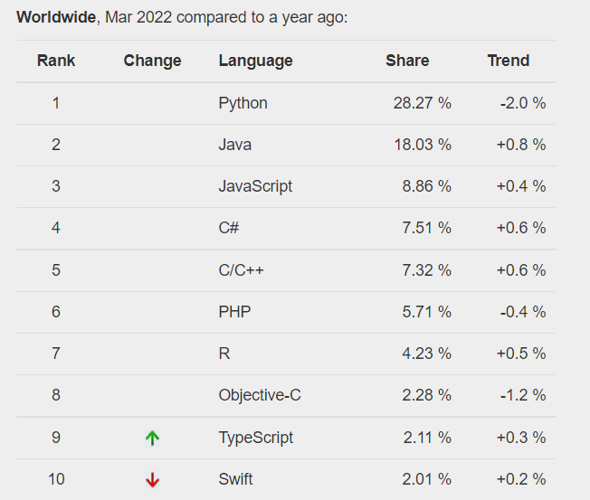
Python Facts
One of the most popular
languages in the world…
continued

Slide 7
Python Printing / Running: 101

Slide 8
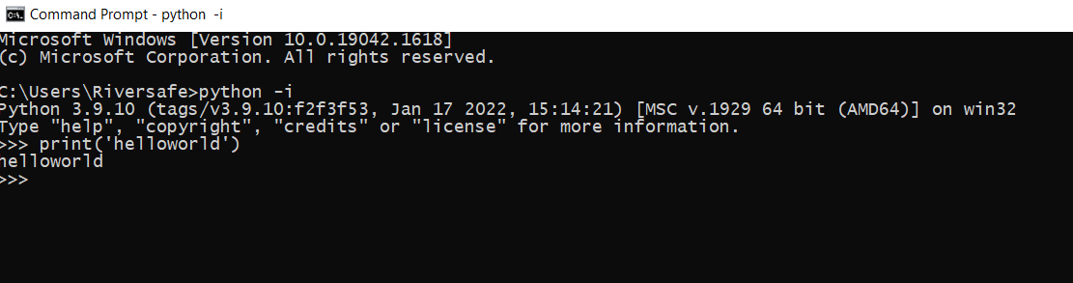
Python Primer: interactive
Jump straight into python with `python -i`

Slide 9
Python Primer: 101
Now deeper…
Comments
Primitives
Functions

Slide 10

Python Primer: Hello World
print('thing'), easy right ?

Slide 11
Python Comments

Slide 12
Python Primer: Comments
Single Line (# comment)
Multi Line ("""comment""") https://python.swaroopch.com/basics.html

Slide 13
Python Primitives

Slide 14
Primitives
Languages have variables for storing data
Will go through common ones
Full list on stdtype docs https://docs.python.org/3/library/stdtypes.html

Slide 15
Primitives
Python’s simple variable types are:
Strings:
'word'
"some words" """cHaRaCtRrS"""
Numbers:
1, 2, 3, 0, -1, 0.5
Booleans:
True/False
Collections:
list = [1,2,3]
dict = {‘name’: ‘anthony’, age: ‘21’}

Slide 16

Primitive: Assignment
Assigning variable
<snake_case_name> = <value>
Variable names always use snake_case not camelCase
Example:
creates a string variable name_message
and runs function print with it

Slide 17
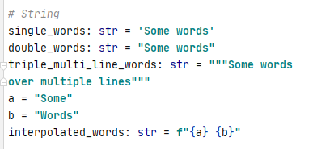
Python Primer: String Primitives
String == List of characters “String-ed” togther
Type Hint = str

Slide 18
Primitives: Quick Syntax Primer
- Strings
- Number
- Boolean
- Collections
aka lists and key valued things

Slide 19
Python Primer: String Primitives
String Escaping (\<SYMBOL>)
Most common is newline ( \n )
Escaped characters can be used inside strings to include quote characters ( \' / \" )
Words: str = 'this is jeff\'s cat'

Slide 20
Python Primer: String Primitives
String Sub slicing [:]
Most common is to remove x characters from start
"dog"[-1:0] == "og"
Or End "dog"[0:1] == "do"
or both "dog"[-1:1] == "o" https://www.geeksforgeeks.org/string-slicing-in-python/

Slide 21

Python Primer: Number Primitives
PS: remember Python can’t count
Reason: Computers count in binary Humans count in decimal Binary / Decimal not great at some fractions Aka 1/3 in decimal is 0.3333333333…

Slide 22
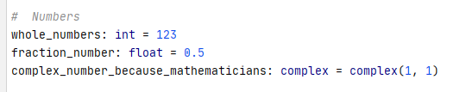
Python Primer: Number Primitives
int == 123 Whole Numbers
float == 0.123 (stored as 123 / 1000) Fraction Numbers
complex == x,y or for 3D x,y,z multi dimensional number are used in some maths, aka 2D graphing / 3D plotting
Type Hint = int / float / complex

Slide 23

Python Primer: Boolean Primitives
Boolean = yes/no aka binary 1/0
Warning: technically 3rd state : None, which is no value
.

Slide 24

Python Collection: Sequence Primitives
list == Array of things
Type hint: list
Remember you need to access via index, var[<index>]
(indexes start from 0 *)

Slide 25
Python Collection: aside on range*
range == dynamic list
Python have built in function for creating lists of sequential numbers * done just-in-time, advanced topic: generator range(<START>,<END>))
list(range(1,5)) == [1,2,3,4]

Slide 26
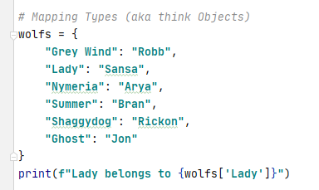
Python Collection: Mapping Primitives
Dict == Key Value pair map
Remember you need to access via key using “[]” var[“KEY”]
Type hint: dict

Slide 27
Python Collection: Accessing list / dict
Access Cheat list: use [<KEY / INDEX>]
some_dict[key_name]
some_list[index starting from 0]

Slide 28
Python Primer: Primitives Overview
It’s close enough to other languages, to be easy to pickup
It’s close enough to other languages, to make silly mistakes
So be careful ☺
So onto Boolean Operators

Slide 29
Python Operators

Slide 30
Python Operators:
bool operators these create bool variables
< less than, aka 1 < 2 : True
<= less than or equal, aka 2 <= 2 : True
> greater than, aka 2 > 1 : True
>= greater than or equal, aka 2 >= 2 : True
== equal by value, aka "this" == "this" : True
!= not equal by value, aka "this" != "that" : True
is equal by reference, aka for collections need to be same var
https://python.swaroopch.com/op_exp.html

Slide 31
Python Operators:
bool operators We’ll cover If, For and While in a second
But these use conditions If X is Y then blah Boolean operators are used to create those conditions
https://python.swaroopch.com/op_exp.html

Slide 32
Python Operators:
Bool chain operators these create bool variables
and (True and True) else False, e.g. True and True => True
or (True and/or True) else False, e.g. True and False => True
not Invert Boolean value, e.g. not True => False
you can chain bool variables or other operators with and/or is_bob_or_jerry:bool = (cat_name == 'bob') or (cat_name == 'jerry')
https://python.swaroopch.com/op_exp.html

Slide 33
Python Control Flow

Slide 34
Python Control Flow
GO TO AMAZING SWAROOPCH GUIDE https://python.swaroopch.com/control_flow.html
Covers important control flow:
if do if condition true
for loop through list of x
while loop until condition not true
Continue skipping item in loop
Break ending loop

Slide 35

Python : Whitespace / indentation
Indention is important in Python use it to enter and leave control flow, aka functions, if, for, etc….
https://python.swaroopch.com/control_flow.html

Slide 36
Python Control Flow
Questions ?

Slide 37
Python Functions

Slide 38
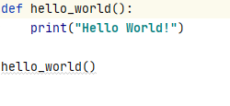
Python Primer: Function
You setup, stored lists of operations to run
Easy right ?
functions always use snake_case not camelCase

Slide 39
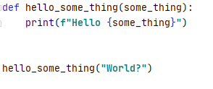
Python Primer: Function Parameters
You can customise your functions with Parameters
Parameters should be snake_case too

Slide 40
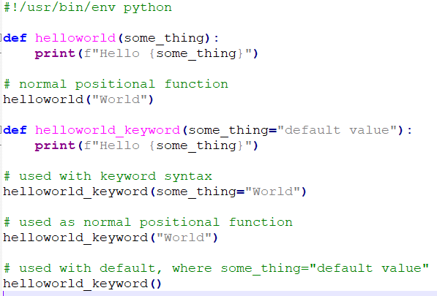
Python Primer: Function Parameters
You can customise your functions with Named Parameters
with Defaults

Slide 41
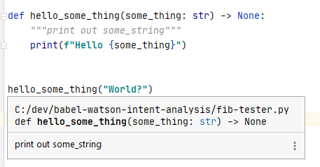
Python Primer: Function DocString
For documenting your code
“““documentation”””
Use typing as well to improve your self documenting code
Ps https://www.python.org/dev/peps/pep-0257/ for more info

Slide 42
Python Primer: Questions
5 mins breather, questions ?

Slide 43
Python Basic
Best Practice

Slide 44
Best Practice
use snake_case for variables and function names * Warning: CamelCase is for Class Names only, discussed next lesson!
use snake_case for python .py filenames
Use docstring ("""<comment>""") for all functions comments
Place empty __init__.py files in all folders containing .py files * DO NOT PUT CODE INTO __init__.py !
use pipfile / poetry for storing external dependencies * fallback to requirements.txt only if it’s all that’s available

Slide 45
Further Reading
https://www.coursera.org/learn/programming-in-python

Slide 46
Thank
you

Slide 47
Questions
I’ve been Anthony M^{c}Kale “Wizard without Portfolio” Fixer-Upper of Broken things, and creator of time-constrained workable Fudges for 15 years. Email : anthony@zapper.hodgers.com

